Slide 1
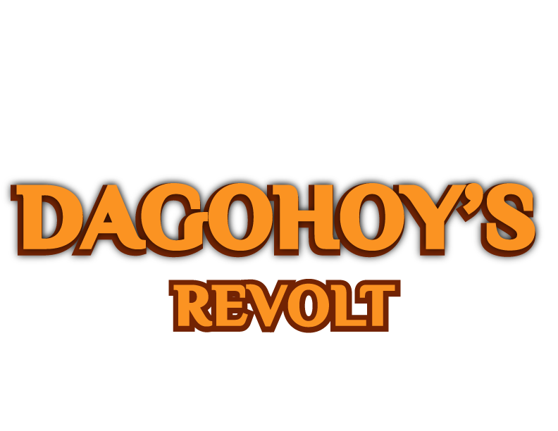
Secret Class

Slide 2
CAPSTONE PROJECT
DAGOHOY’S REVOLT: 3D EDUCATIONAL GAME ABOUT DAGOHOY

Slide 3
Chapter I
Introduction

Slide 4
Project Context
There are many national heroes in the Philippines, just like Jose Rizal, Lapu-Lapu, and many more. However, some of them do not get the recognition they deserve. Furthermore, one of them is Francisco Dagohoy.
People knew the name Dagohoy, but they do not recognize who he is. What is worst is that even his fellow Boholanos does not know him well.

Slide 5
Project Context
Some people are fond of reading, but other individuals are visual learners. Those are the individuals who learn best through visual objects.
We, the researchers, came up with an idea to do an educational and entertaining project. We decide to create a 3D game that aims to educate the user about our hero Francisco Dagohoy.
We believe that smartphones and computers can also be used not just for entertainment but also for education.

Slide 6
Statement of the Problem
People knew the name Dagohoy, but they do not recognize who he is. What is worst is that even his fellow Boholanos does not know him well.
This research project aims to educate people about Francisco Dagohoy by creating a 3D Educational Game.
How will we be able to educate the people?
What is the difference between the traditional way of learning to non-traditional way?
Can the game be played without an internet connection?
How to distribute the game? ­­

Slide 7
PURPOSE
The purpose of this project is to educate people about Bohol’s history. Specifically, one of Bohol’s mighty hero Francisco Dagohoy.
This project is good because we believe this is a timely solution. Incorporating this project into a game makes it more interesting for the user.

Slide 8
OBJECTIVES
The main objective of this project is to create a game that is both educational and also entertaining.
To create game that will have a campaign/story mode that tells the story of Francisco Dagohoy’s revolt.
To create a game playable for PC and Mobile device and it can be played online and offline.
To create a website which contains the download page and trailer of the game.

Slide 9
Significance of the Study
Children and Youth
This project will enlighten them about one of major events of the history in Bohol.
Future Researchers
This project will help the build their ground on how to start and develop an Educational game.

Slide 10
Scope and Limitations
SCOPE
LIMITATIONS
3D Adventure, RPG (Role Playing Game)
Campaign/Story Mode about Dagohoy’s Revolt.
Extra quiz game essential details of Dagohoy.
Downloadable for Android and Windows.
Playable on Computer Browser.
The story do not cover Francisco Dagohoy’s entire life.
Not available on Google Play Store and Steam.
Not available for IOS device.

Slide 11
Chapter II
Review of Related Literature

Slide 12
Review of Related Literature
According to the article of Teemu H. Laine (2018) entitled “Mobile Educational Augmented Reality Games: A Systematic Literature Review and Two Case Studies”, she define mobile AR as a type of AR where a mobile device (smartphone or tablet) is used to display and interact with virtual content, such as three-dimensional (3D) models, annotations, and videos, that are overlaid on top of a real-time camera feed of the real world.

Slide 13
Review of Related Literature
Libradilla et al., (2015) in their research “Teaching Effectively with Use of Game-Based Interactive Mathematics,” it determined the interest of the pupils to learn math because of the features of the game such as colors, graphics, sounds and time element that makes it more engaging and fun.

Slide 14
Review of Related Literature
Katrina Serrano (2019) published a research paper entitled “The effect of digital game-based learning on student learning: A literature review” in University of Northern Iowa, examines the effect of digital game-based learning on student learning.

Slide 15
Review of Related Literature
McKenzi James (2020) published a Master’s Theses & Capstone Project entitled “The Impact of Game-Based Learning in a Special Education Classroom” in Northwestern College, in which studied about a teacher having at least one student who has a learning disability or struggles with academics.

Slide 16
Review of Related Literature
According to the article of Ramon Cozar-Gutierrez & Jose Manuel Lopez (2016) entitled “Game-based learning and gamification in initial teacher training in the social sciences: an experiment with MinecraftEdu”, their study analyses the application of game-based learning and gamification using MinecraftEdu, which allows for an exploration of the possibilities regarding immersive learning environments.

Slide 17
Educational games are not today. Since the introduction of video games on 1970’s a lot of games are released that are considered as an educational game.
Historical Background
Logo Programming
Lemonade Stand
Oregon Trail
Minecraft

Slide 18
Chapter III
Technical Backgroud

Slide 19







Technical Background
C#
Unity
Visual Studio Code
Blender
Adobe Photoshop
Adobe Illustrator
Vue.js

Slide 20
Thank You!

Slide 21

Game Prototype

